Slide 1
Optimizations
Building Personal Websites
Lecture 12 | Optimizations

Slide 2
Optimizing Screen Sizes
Cross-Browser Support
Building Personal Websites
Lecture 12 | Optimizations

Slide 3
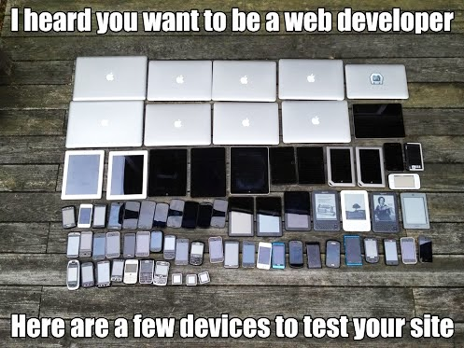
Building Personal Websites
Lecture 12 | Optimizations

Slide 4
Breakpoint Examples
3 main devices to consider:
width > 1024px
1024px > width > 480px
480px > width > 250px
Building Personal Websites
Lecture 12 | Optimizations

Slide 5
Breakpoint Examples
Can be reduced down to 2:
width > 780px
780px > width > 250px
Building Personal Websites
Lecture 12 | Optimizations

Slide 6
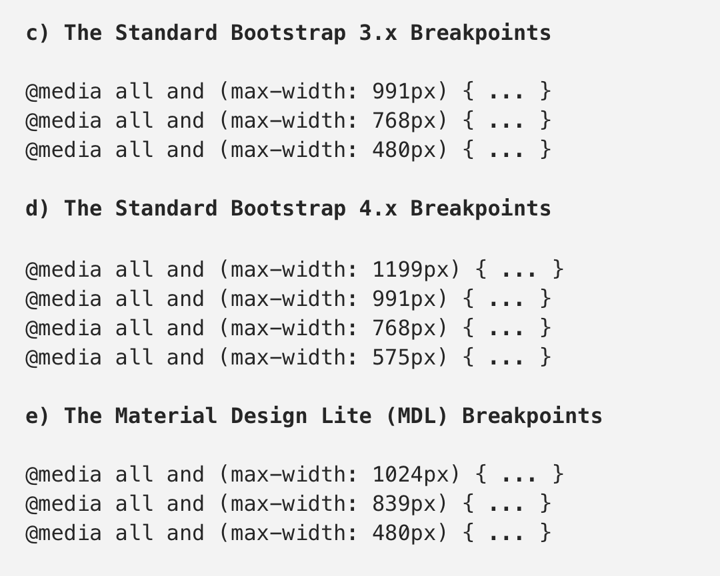
Breakpoint Examples
Example of how bootstrap sets breakpoints:
src: https://medium.com/@uiuxlab/the-most-used-responsive-breakpoints-in-2017-of-mine-9588e9bd3a8a
Building Personal Websites
Lecture 12 | Optimizations

Slide 7
Media Queries
Executes code in brackets if width <= max-width
@media (max-width: 1000px) { … }
Executes code in brackets if width >= max-width
@media (min-width: 1000px) { … }
@media queries can check:
Screen widths and heights
Screen resolutions
Orientation
src: https://medium.com/@uiuxlab/the-most-used-responsive-breakpoints-in-2017-of-mine-9588e9bd3a8a
Building Personal Websites
Lecture 12 | Optimizations

Slide 8
Setting Breakpoints
Sets CSS properties for different screen widths:
(Regular CSS…)
@media (max-width: 1024px) {
(Tablet CSS…)
}
@media (max-width: 480px) {
(Phone CSS…)
}
Only executed if width < 1024
Only executed if width < 480
Building Personal Websites
Lecture 12 | Optimizations

Slide 9
Setting Breakpoints
What is the font size on a 1920x1080 display? On a 720x480 display?
p { font-size: 18px; }
@media (max-width: 1024px) {
p { font-size: 14px; }
}
@media (max-width: 480px) {
p { font-size: 12px; }
}
1920x1080
720x480
Building Personal Websites
Lecture 12 | Optimizations

Slide 10
Optimizing Screen Sizes
Cross-Browser Support
Building Personal Websites
Lecture 12 | Optimizations

Slide 11
Fallback Support
Not all browsers share the same modern-day HTML features
CSS features
JQuery features
You can set fallback behaviors such as displaying text or images in place of failed-to-load content
The default fallback is to not display at all (skip over the element)
Building Personal Websites
Lecture 12 | Optimizations

Slide 12




CSS in Various Browsers
Each browser uses their own kit for transformations:
.move-me:hover { -ms-transform: translate(0%, 42%);
-webkit-transform: translate(0%, 42%);
-moz-transform: translate(0%, 42%);
-o-transform: translate(0%, 42%);
}
Building Personal Websites
Lecture 12 | Optimizations

Slide 13
CSS in Various Browsers
How to tell if a browser has a specific CSS property tag?
Try the default tag.
Test in every browser.
If it fails in one browser, google the tag and the browser name followed by ‘not working’.
Stack Overflow and similar sites will tell you how to fix it.
Building Personal Websites
Lecture 12 | Optimizations

Slide 14
Homework Ideas
Test site across multiple browsers and devices.
Correct cross-browser errors (usually by searching them).
Add media queries to set breakpoints for CSS properties.
Building Personal Websites
Lecture 12 | Optimizations

Slide 15
Live Demo
Building Personal Websites
Lecture 12 | Optimizations

